Slide 1




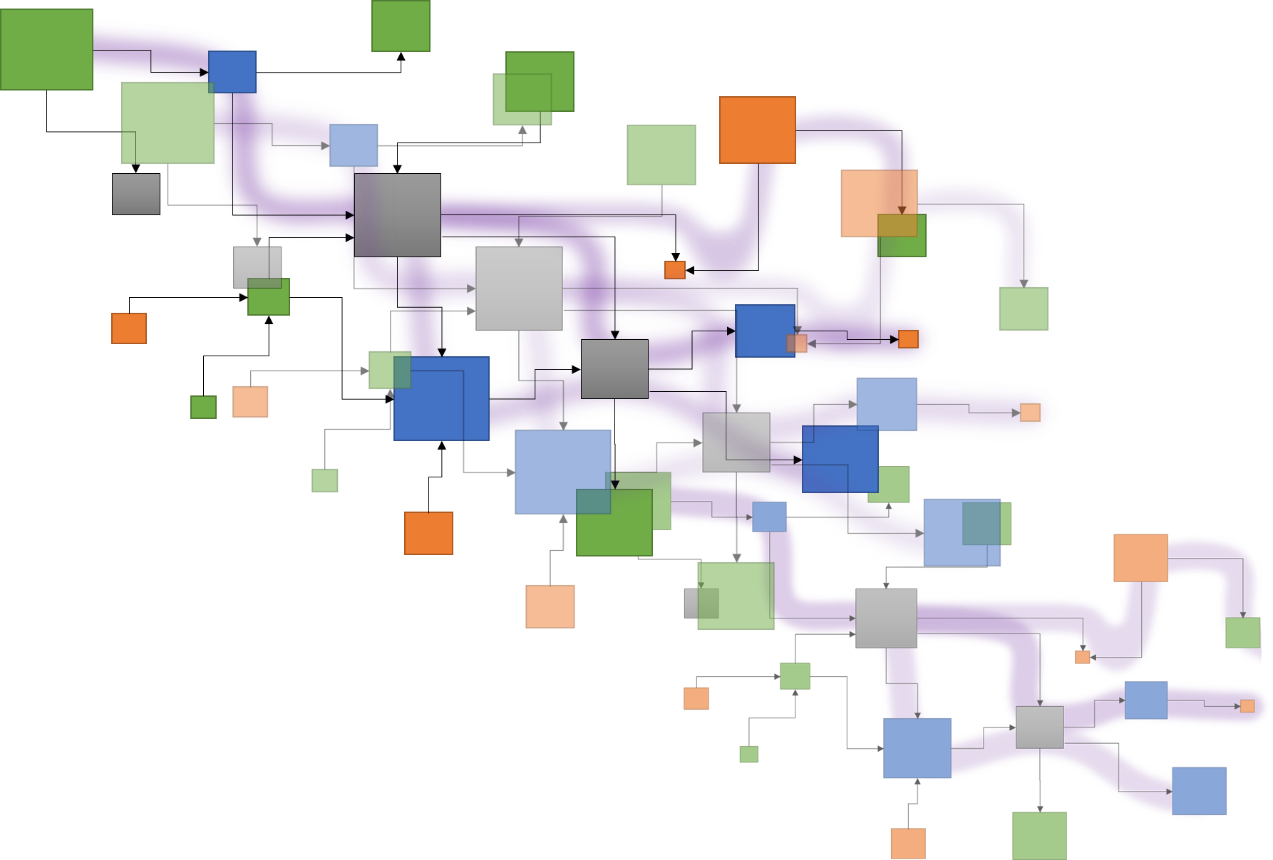


Tracea – 6th deliverable
A study of Papyrus –
Topology and complexity of DSL orchestration..
.. a semi-automated analysis
Task 6:
Evaluation of the potential advantages of using the distance valuation for dealing with the complexity of traceability. Potential study case: establish a heat chart for the change impact analysis.
Exploring Papyrus DSL orchestration
Deliverable 6:
Case study. Exploration of different scenarios that would benefit from a socio-technical traceability language or distance functions to reduce accidental complexity thanks to tracing. (For example: customization of views according to the "distance" between the artefacts on a matrix heat chart).
Edouard R. Batot
Mai 2022

Slide 2
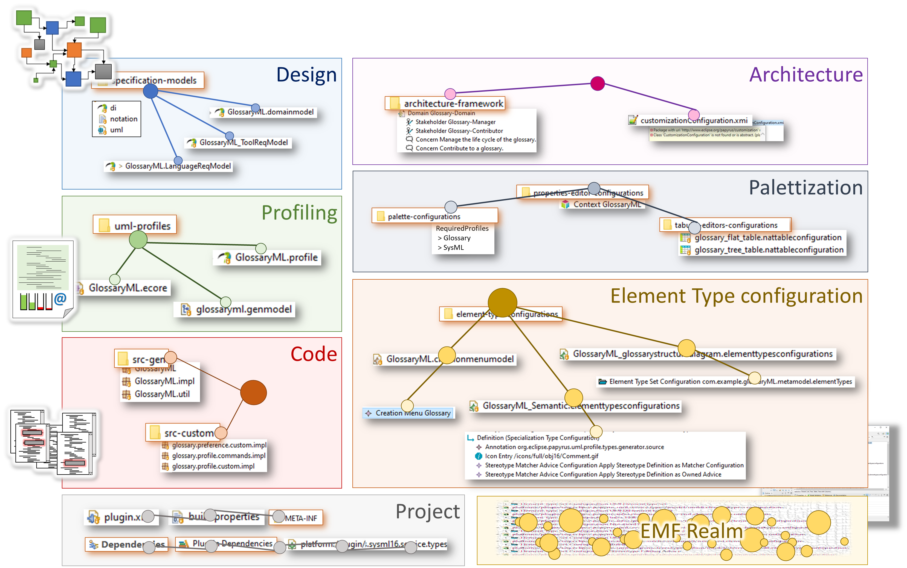
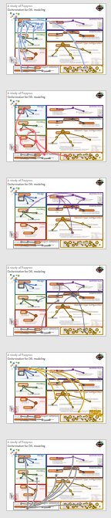
Orchestration for DSL modeling: A study of Papyrus
Papyrus modules & dependencies
Reference forensic.

Slide 3
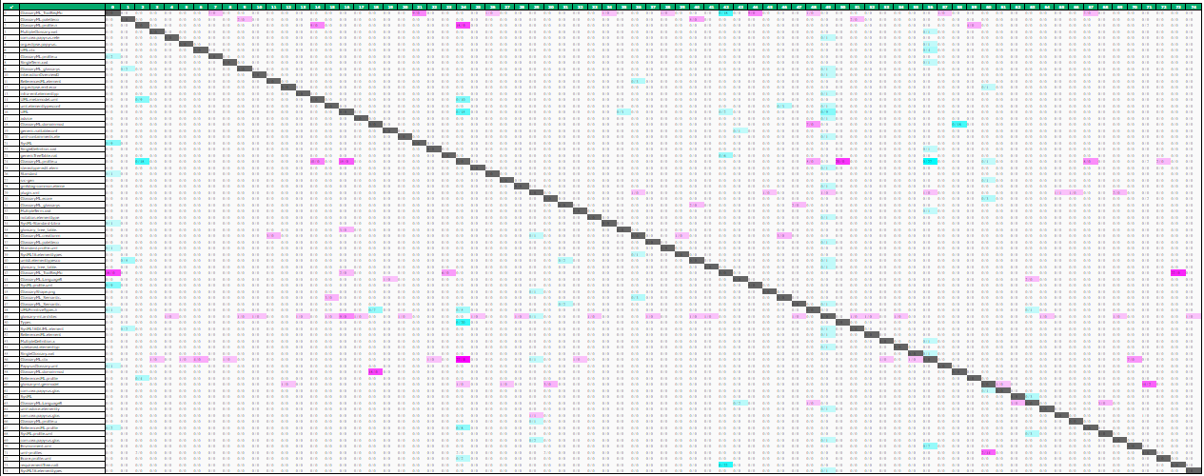
Complexity & Topology in
a Papyrus project
Weighted adjacency matrix
Matrix heat chart
Exploring Papyrus DSL orchestration

Slide 4
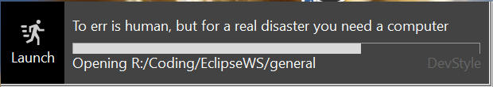
Deliverable 6
Traceα
Topology and complexity of
Papyrus DSL creation
Edouard R. Batot
Mai 2022

Slide 5
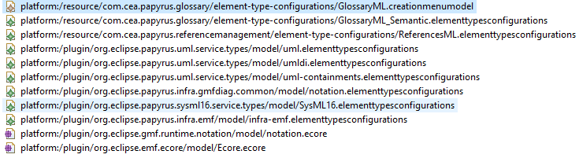
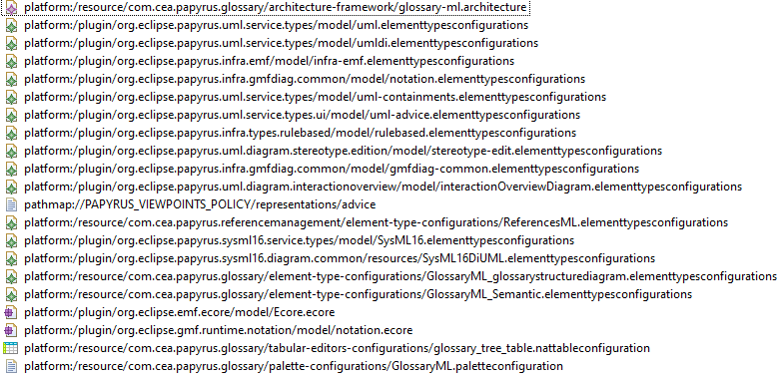
Orchestration for DSL modeling: A study of Papyrus
EMF ResourceSets & Resources
Definition
Usages
Related project
CreationMenu resources
Architecture resources

Slide 6
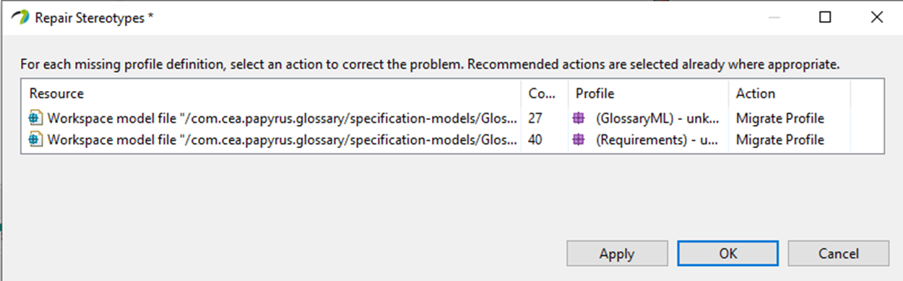
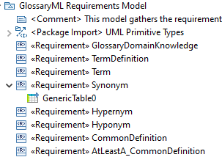
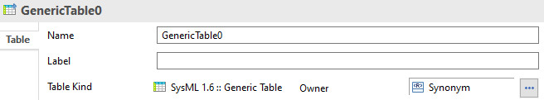
Orchestration for DSL modeling: A study of Papyrus
Papyrus external elements
Missing
Profile / Definition ?
Domain – SysML
Dependency

Slide 7
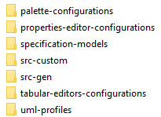
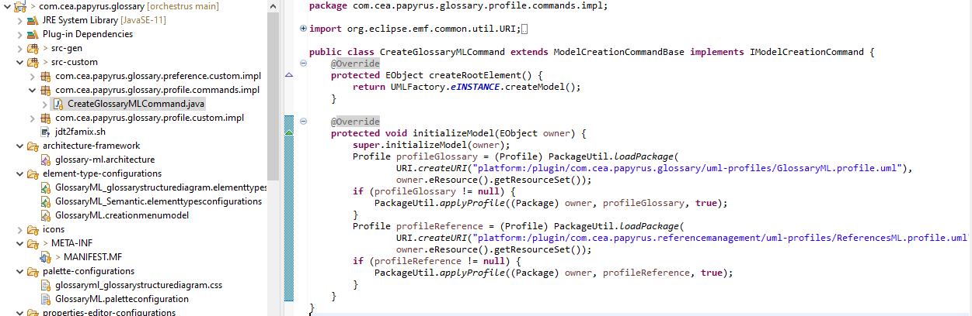
Orchestration for DSL modeling: A study of Papyrus
Customization and dependencies

Slide 8
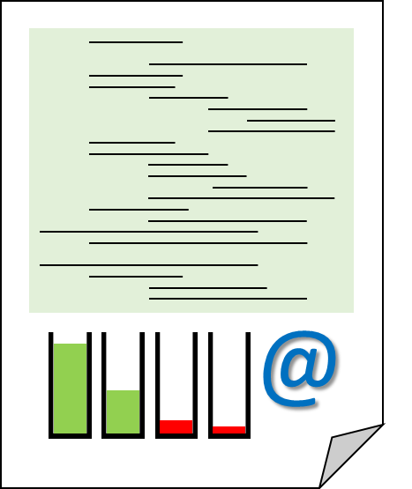
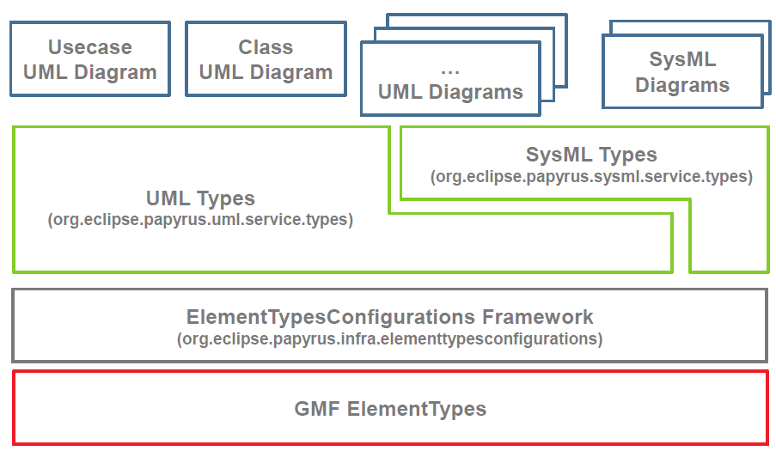
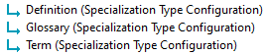
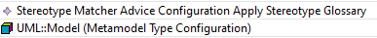
Orchestration for DSL modeling: A study of Papyrus
Element type configurations:
from domain model to EMF representations
? Related projects ?
Glossary
DSL
Reference management DSL

Slide 9
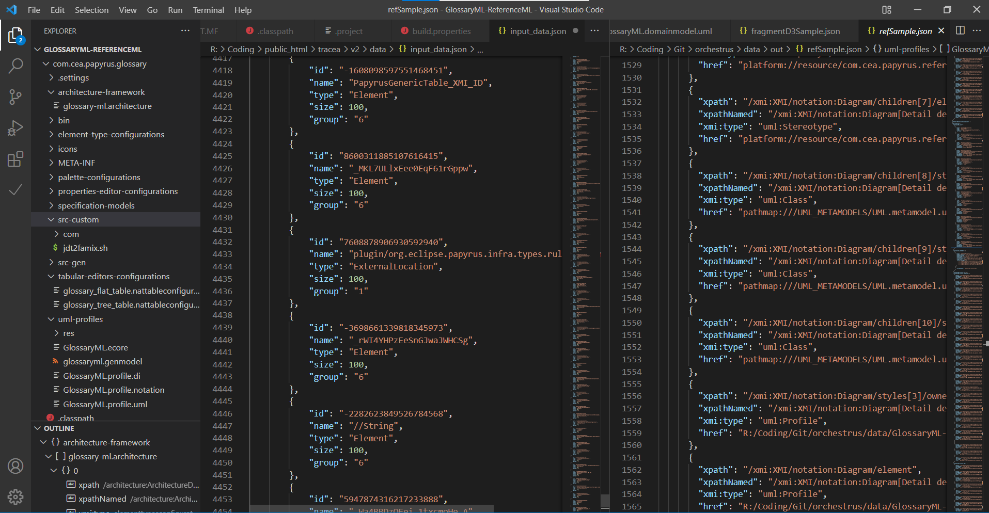
Persistence break.
XMI
Artefacts
Configuration
Exploring Papyrus DSL orchestration
Custom
Java
Modeling
persistence

Slide 10
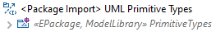

Reference forensic.
Root folder
Root
Path to element
Path to element
External Element
Path to element
UML primitive
Exploring Papyrus DSL orchestration
Related
libraries
External Element
View
Context
SysML/Req
Local Element
Design
Architecture
Palettization
External location
Local file
Profiling
Element Type configuration
Code
Related project
Project
EMF Realm
Local root

Slide 11
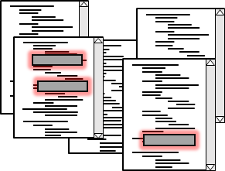
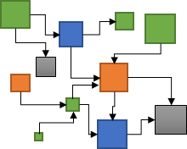
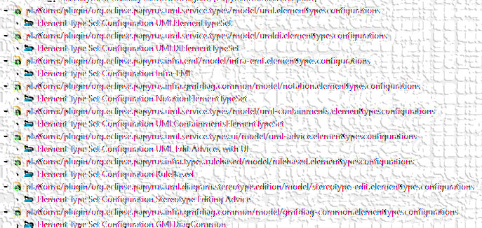
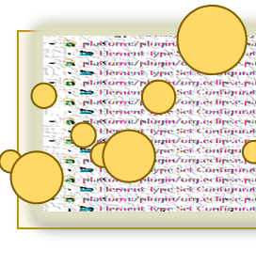
Reference forensic.
XML et al.
Java files
What is a reference
Nature, source
Solvability
What matters in a reference
Source file, target,
Frequency?
XMI
Exploring Papyrus DSL orchestration
"href": "platform://plugin/org.eclipse.papyrus.uml.service.types/model/
uml.elementtypesconfigurations
#_ScP1oFYCEeS0WsAAtVmToA"
HREF
Protocol
://
location
Context
name
#
File artefact
innerlocation
URI
Precise target element
SysML
Ecore
EMF Realm

Slide 12
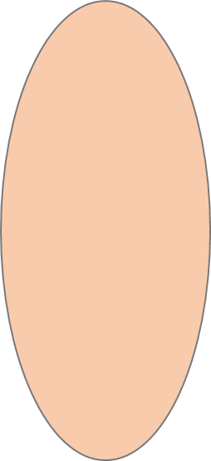
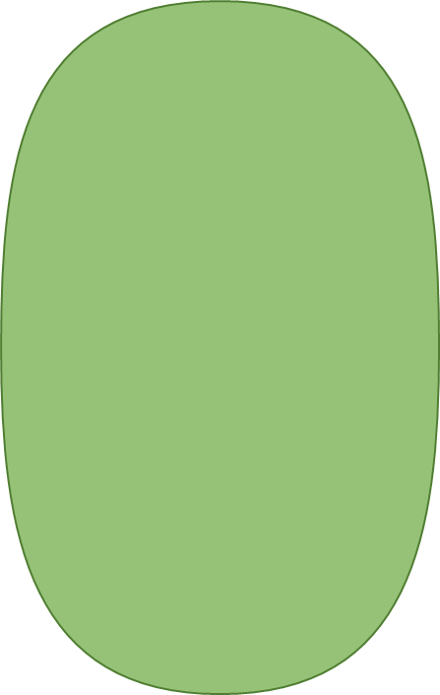
Reference forensic.
Reference forensic
Exploring Papyrus DSL orchestration
Dependences
Related
Projects
External locations
Unresolved locations

Slide 13
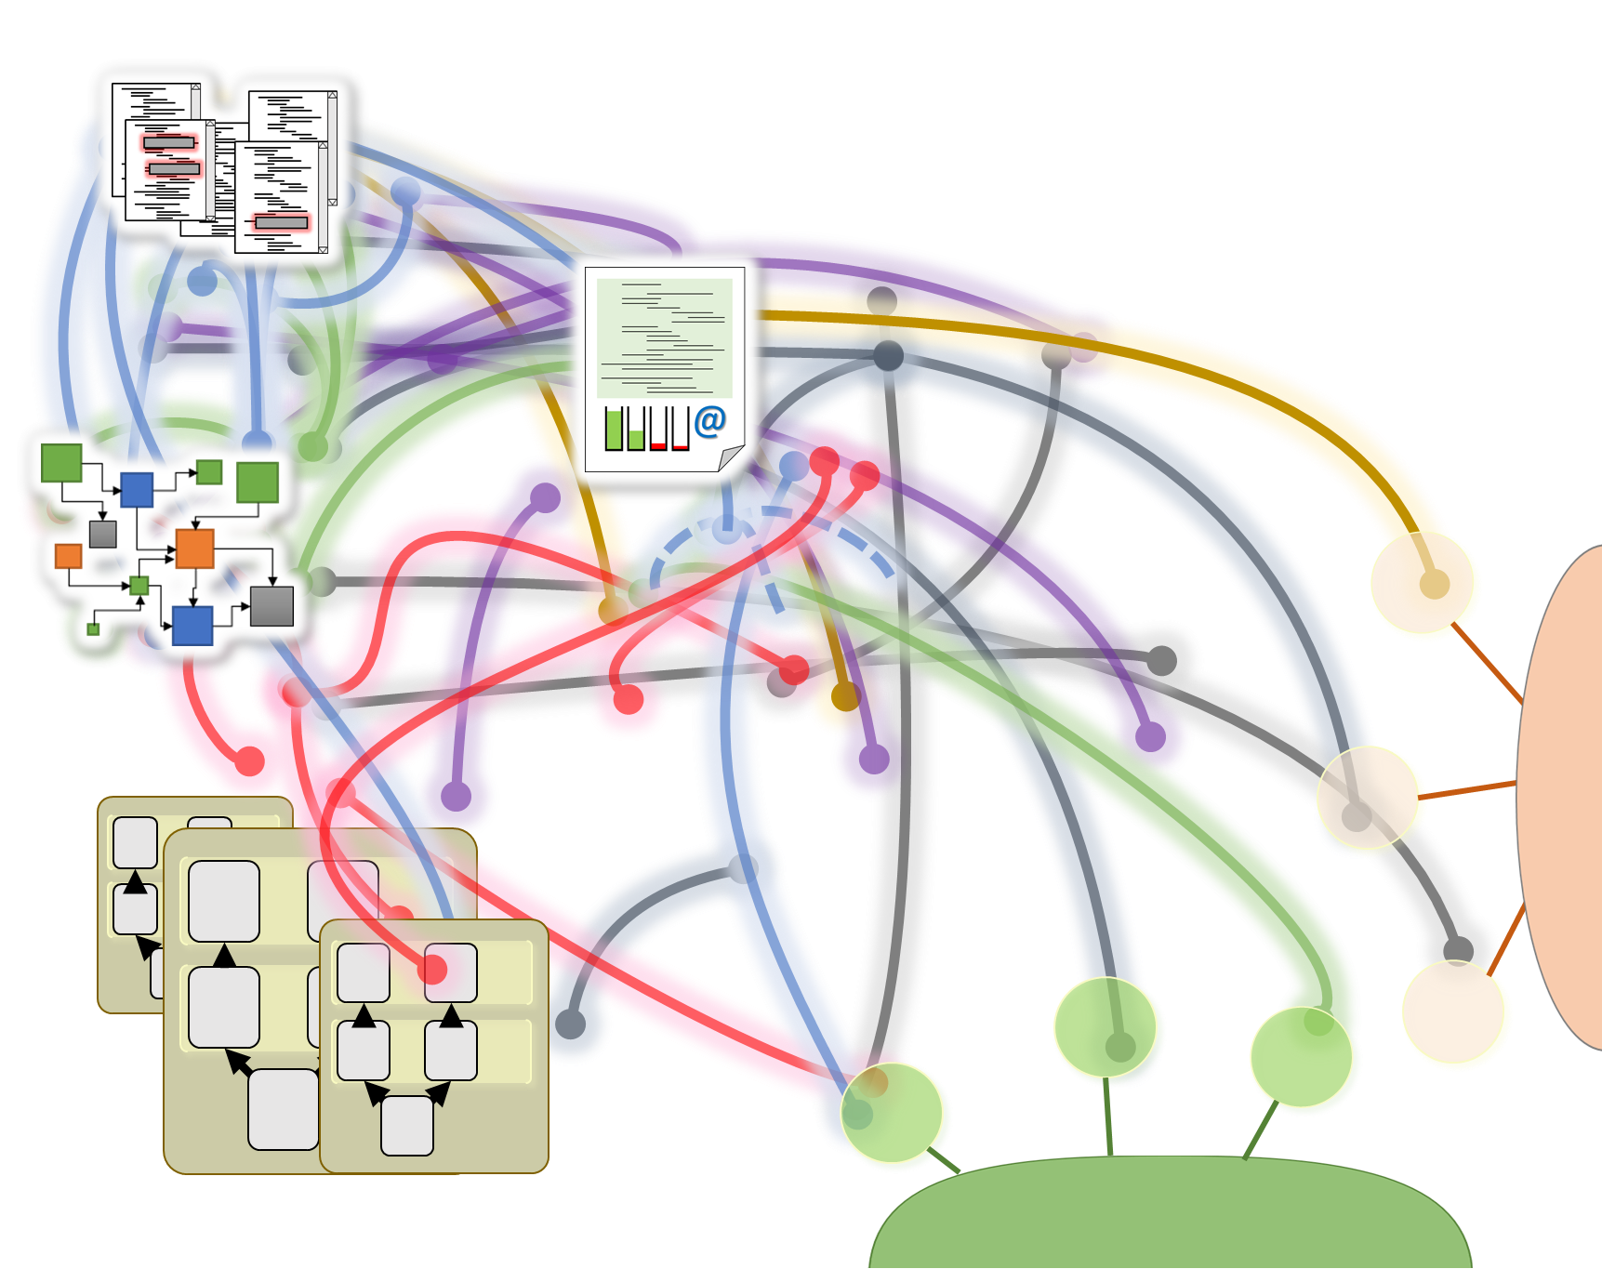
Reference forensic.
Impacted elements
Reference forensic
Design
Inter-module connections map
Code
Profiling
Maps modules external dependencies
Eases exploration of dependencies
Guides connections typing
Exploring Papyrus DSL orchestration
Architecture
Element Type configuration
Palettization

Slide 14

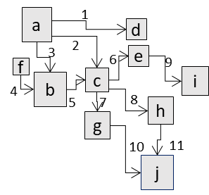
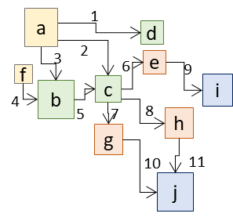


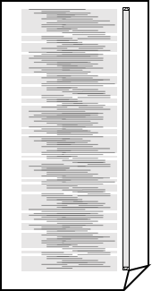
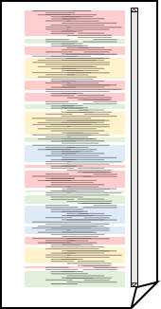

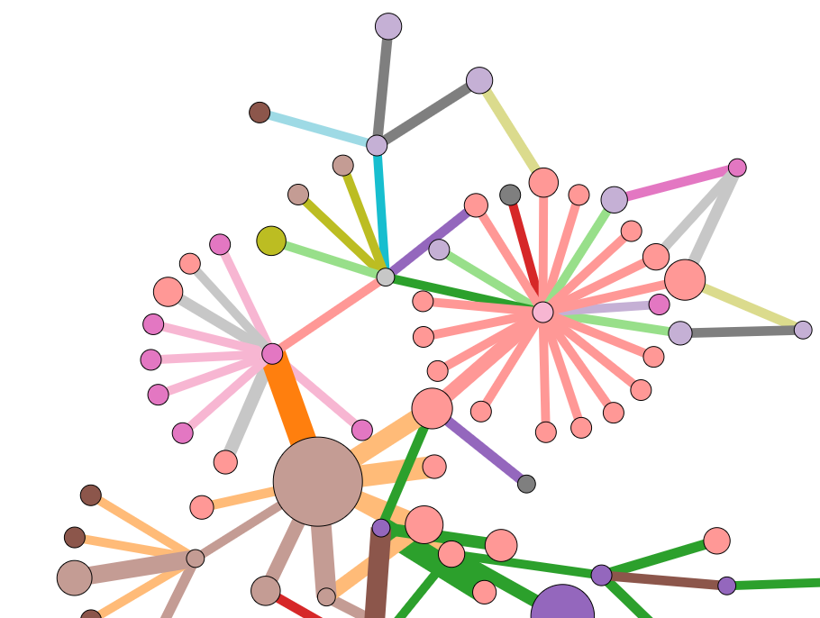
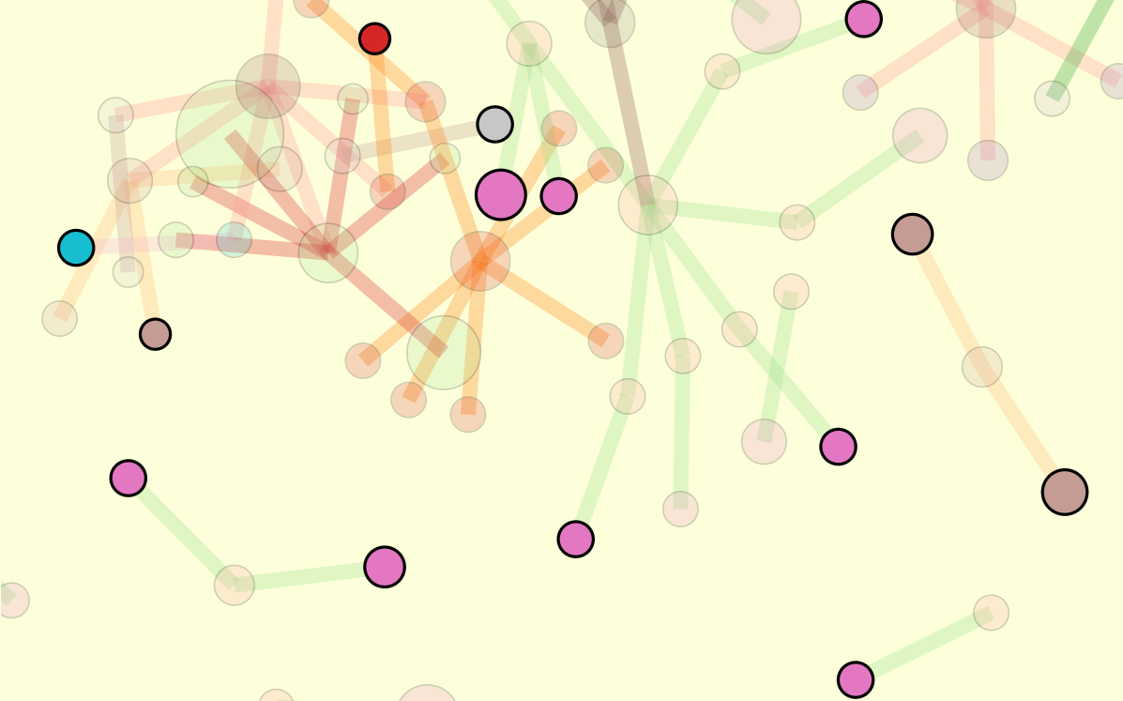
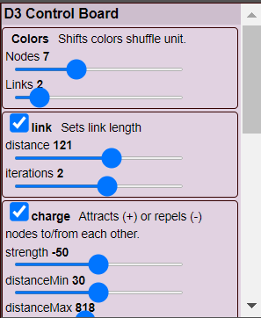
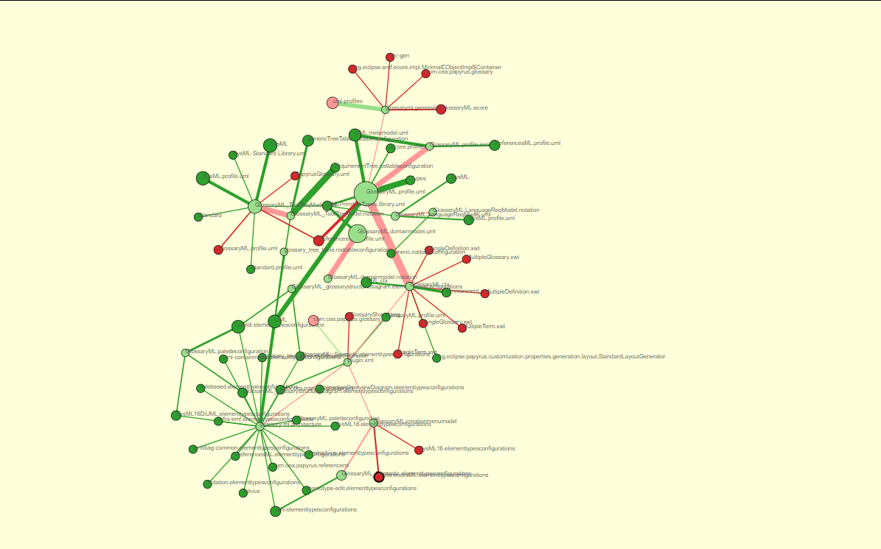
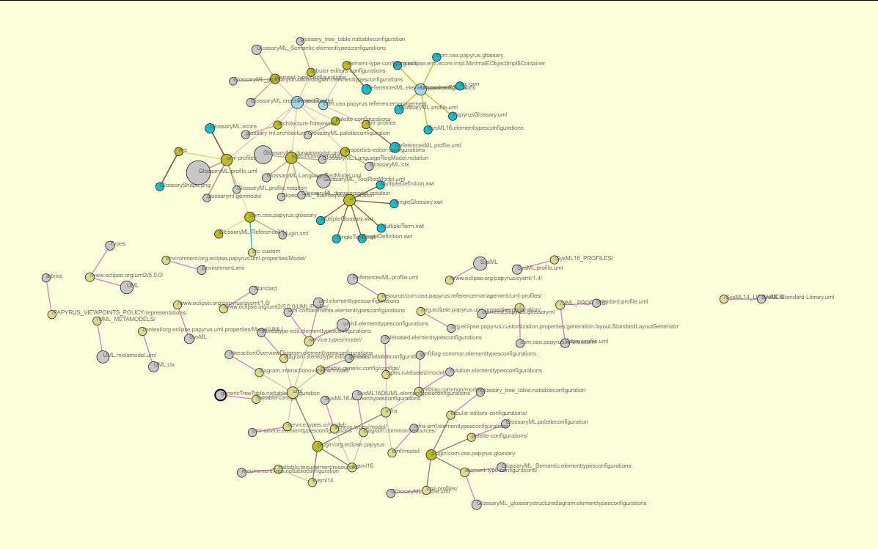
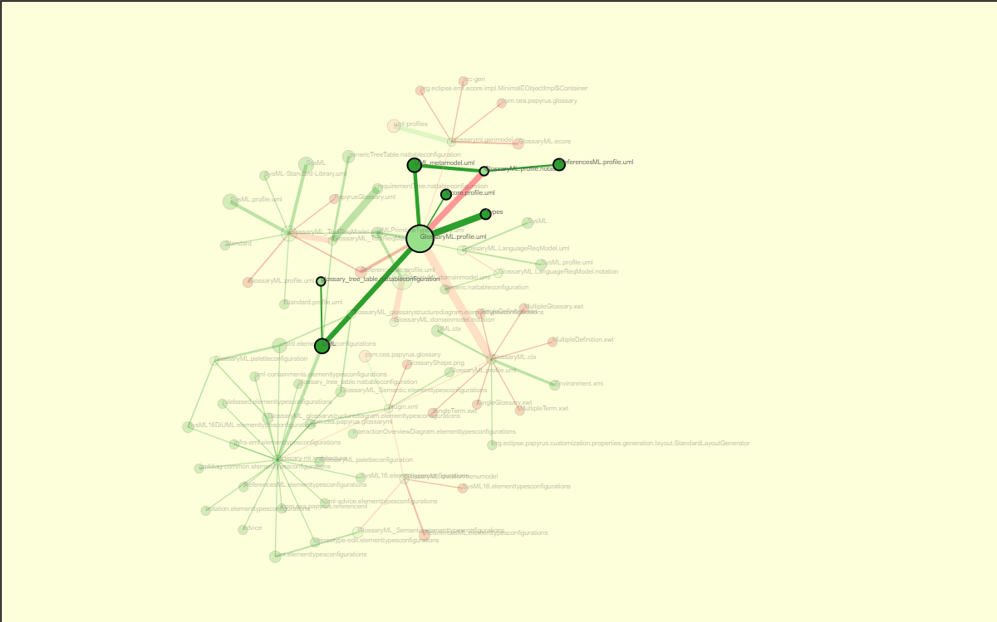

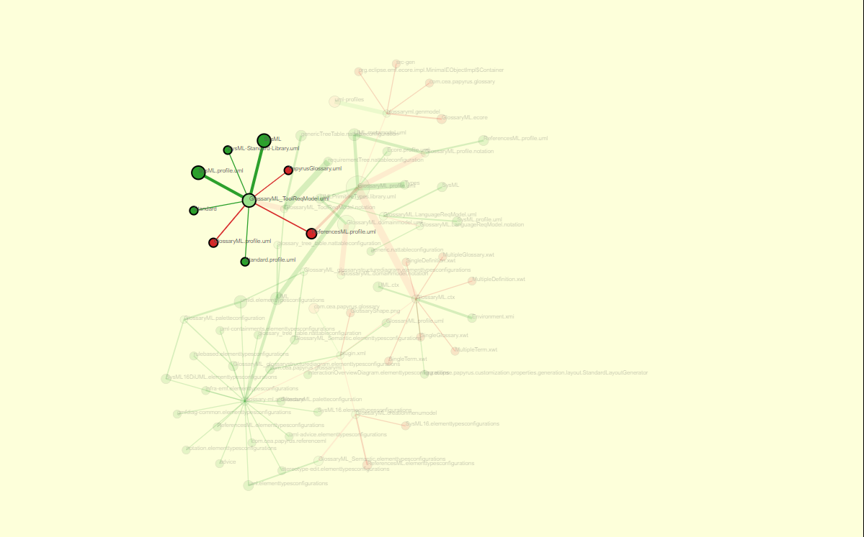
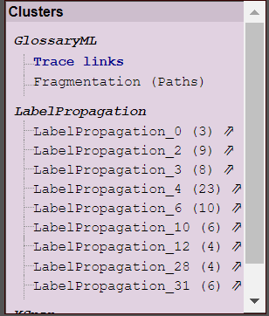
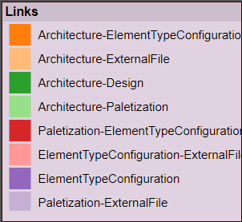
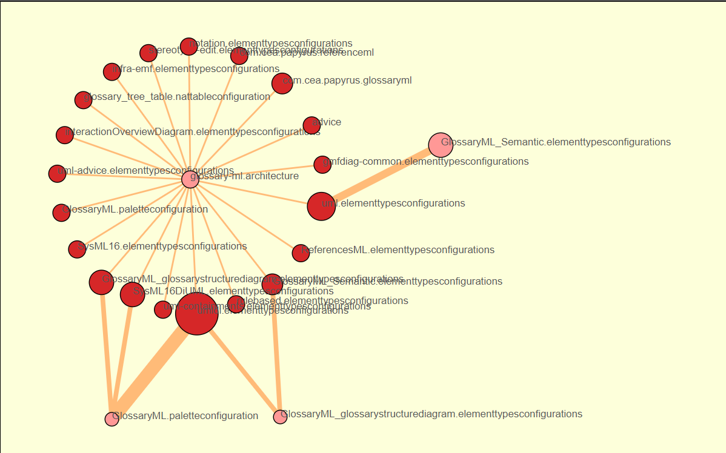
Topology and complexity of Papyrus-based DSL creation: A semi-automated analysis
1
2
3
·
Orchestrus: Analyzing Papyrus DSL artefacts relationship
Tracea
Papyrus DSL project
Relationship identification
TraceaML instantiation
Artefacts and links valuation
a
d
Typed trace
c
e
DSL persistence
References
Trace
f
h
b
g
Parsing
j
i
Modeling
Typing
Configuration
- Folders
- Dependencies
- Src-custom
- Specific formats
{Json}
{Json}
{Json}
Artefacts
Fragmentation and Relationships
Artefacts
Fragmentation and Relationships
List of references
Papyrus persistence
Visualization with TraceaD3
JSon
Relationships
Fragmentation
Java
Tracea
TraceaD3
D3
Orchestrus
Sensitive areas
Interaction
- Browse & search
- Emphasize clusters
- Show paths
TraceaML
Notes:
14

Slide 15
Topology and complexity of Papyrus-based DSL creation: A semi-automated analysis
1
2
3
·
Orchestrus: Analyzing Papyrus DSL artefacts relationship
Tracea
Papyrus DSL project
Relationship identification
TraceaML instantiation
Artefacts and links valuation
a
d
Typed trace
c
e
DSL persistence
References
Trace
f
h
b
g
Parsing
j
i
Modeling
Typing
Configuration
- Folders
- Dependencies
- Src-custom
- Specific formats
{Json}
{Json}
{Json}
Artefacts
Fragmentation and Relationships
Artefacts
Fragmentation and Relationships
List of references
Visualization with TraceaD3
Tracea
Relationships
Fragmentation
Sensitive areas
Interaction
- Browse & search
- Emphasize clusters
- Show paths
Notes:
15

Slide 16
Topology and complexity of Papyrus-based DSL creation: A semi-automated analysis
1
2
3
·
Orchestrus: Analyzing Papyrus DSL artefacts relationship
Tracea
Papyrus DSL project
Relationship identification
TraceaML instantiation
Artefacts and links valuation
a
d
Typed trace
c
e
DSL persistence
References
Trace
f
h
b
g
Parsing
j
i
Modeling
Typing
Configuration
- Folders
- Dependencies
- Src-custom
- Specific formats
{Json}
{Json}
{Json}
Artefacts
Fragmentation and Relationships
Artefacts
Fragmentation and Relationships
List of references
Visualization with TraceaD3
Tracea
Relationships
Fragmentation
Sensitive areas
Interaction
- Browse & search
- Emphasize clusters
- Show paths
Notes:
16

Slide 17
Topology and complexity of Papyrus-based DSL creation: A semi-automated analysis
1
2
3
·
Orchestrus: Analyzing Papyrus DSL artefacts relationship
Tracea
Papyrus DSL project
Relationship identification
TraceaML instantiation
Artefacts and links valuation
a
d
Typed trace
c
e
DSL persistence
References
Trace
f
h
b
g
Parsing
j
i
Modeling
Typing
Configuration
- Folders
- Dependencies
- Src-custom
- Specific formats
{Json}
{Json}
{Json}
Artefacts
Fragmentation and Relationships
Artefacts
Fragmentation and Relationships
List of references
Visualization with TraceaD3
Tracea
Relationships
Fragmentation
Sensitive areas
Interaction
- Browse & search
- Emphasize clusters
- Show paths
Notes:
17

Slide 18
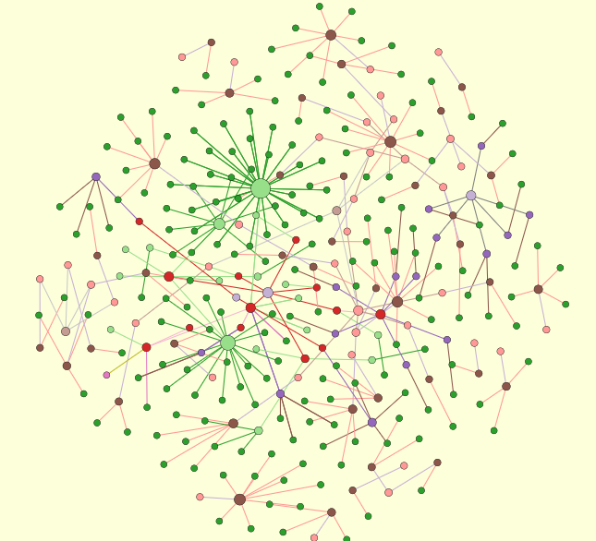
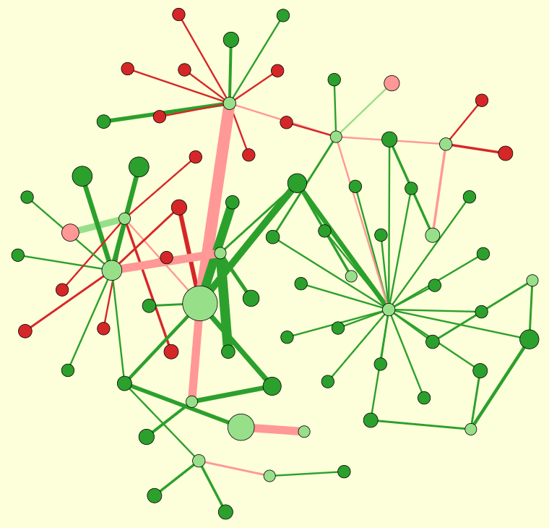
TraceaML instantiation
Artefacts and links valuation
a
d
c
e
References
Trace
Typed trace
f
h
b
g
j
i
Modeling
Typing
Artefacts
Fragmentation and Relationships
Artefacts
Fragmentation and Relationships
{Json}
Exploring Papyrus DSL orchestration
{Json}
Fragmentation
Relationships
Topology
Complexity

Slide 19
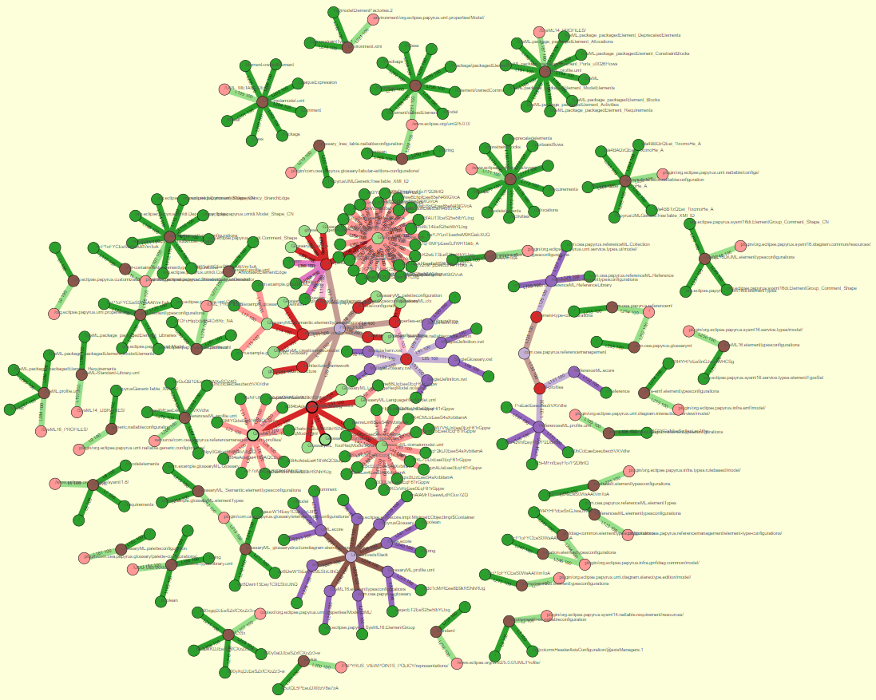
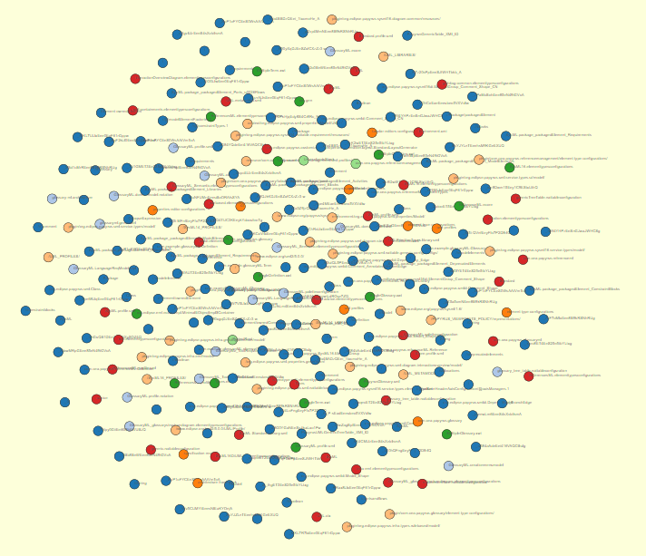
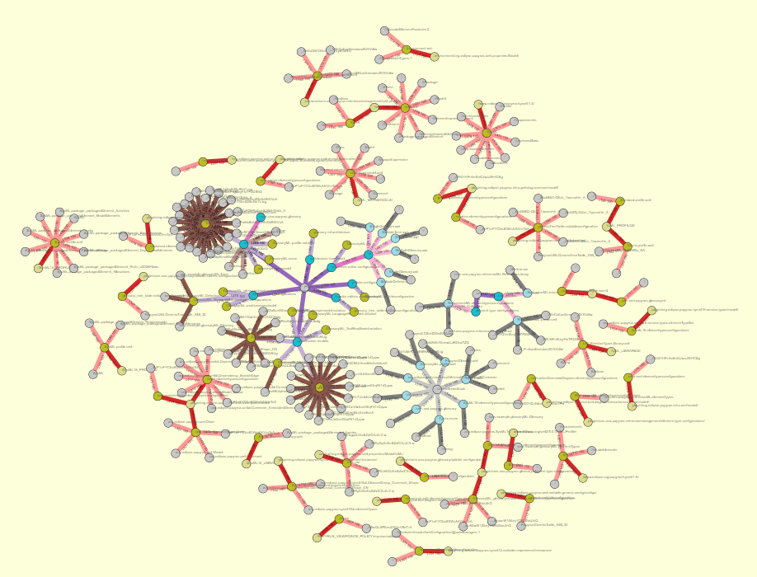
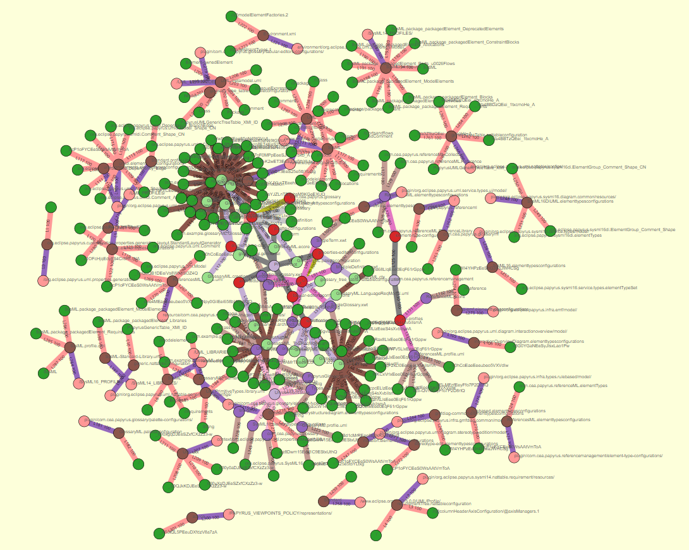
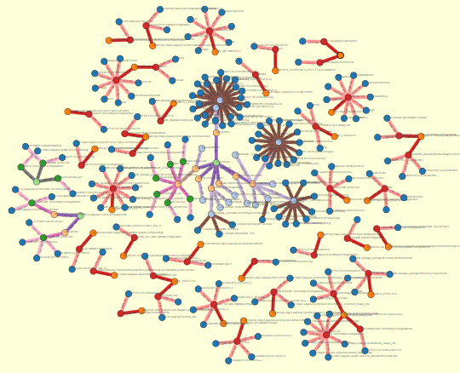
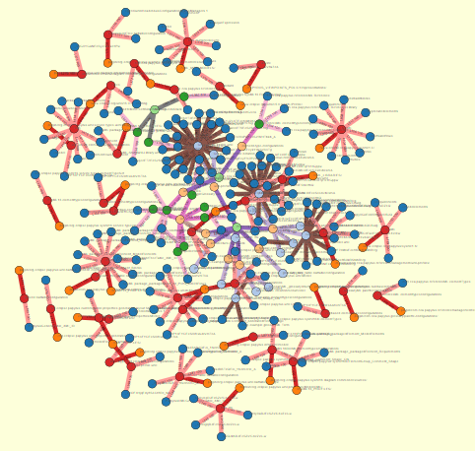
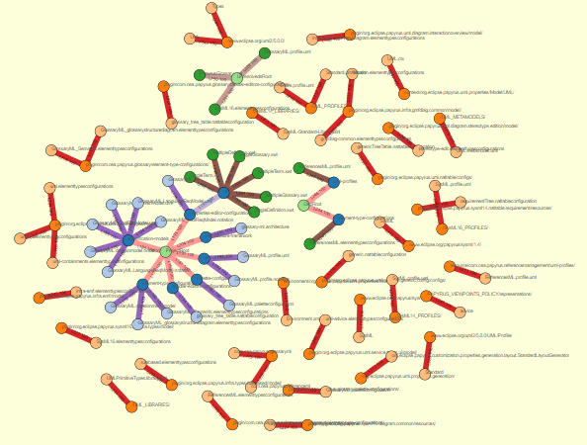
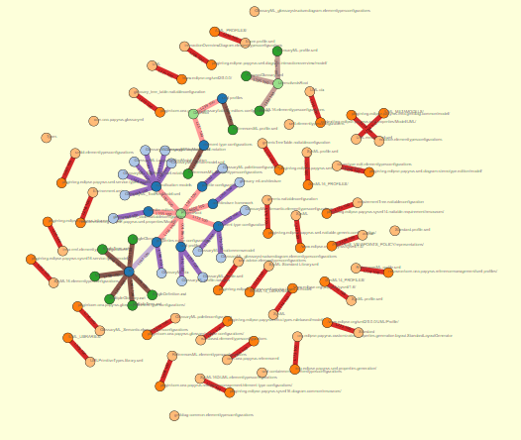
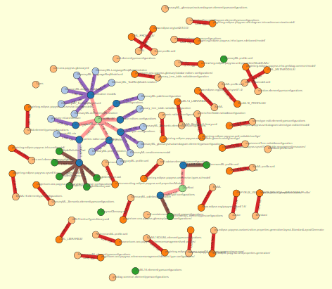




Topology of
a Papyrus project
Exploring Papyrus DSL orchestration
data/input_trace_data.json&nc=4&lc=4

Slide 20







Topology of
a Papyrus project
Papyrus
“Phases”
Exploring Papyrus DSL orchestration
UML
GlossaryML
SysML
Unresolved
ReferenceML

Slide 21
Topology of
a Papyrus project
Artefacts valuation
Exploring Papyrus DSL orchestration

Slide 22



















Topology of
a Papyrus project
Artefacts valuation
Exploring Papyrus DSL orchestration
The bigger an element,
The most accessed

Slide 23


Complexity of
a Papyrus project
Relationships valuation
Exploring Papyrus DSL orchestration

Slide 24
Complexity of
a Papyrus project
Relationships valuation
Exploring Papyrus DSL orchestration
The larger a link,
The most intense the relation

Slide 25




Complexity & Topology in
a Papyrus project
Exploring Papyrus DSL orchestration

Slide 26



Complexity & Topology in
a Papyrus project
Exploring Papyrus DSL orchestration
¿Topology & Complexity
in a single perspective?
¿?

Slide 27




Intangible future.
Topology
Complexity
Exploring Papyrus DSL orchestration

Slide 28

Topology and complexity of Papyrus-based DSL creation: A semi-automated analysis
DSL persistence
Notes:
28

Slide 29
Topology and complexity of Papyrus-based DSL creation: A semi-automated analysis
Notes:
29

Slide 30
Topology and complexity of Papyrus-based DSL creation: A semi-automated analysis
Orchestrus: Analyzing Papyrus DSL artefacts relationship
Tracea
Papyrus DSL project
Relationship identification
TraceaML instantiation
Artefacts and links valuation
a
d
Typed trace
c
e
DSL persistence
References
Trace
f
h
b
g
Parsing
j
i
Modeling
Typing
Configuration
- Folders
- Dependencies
- Src-custom
- Specific formats
{Json}
{Json}
{Json}
Artefacts
Fragmentation and Relationships
Artefacts
Fragmentation and Relationships
List of references
Papyrus persistence
Visualization with TraceaD3
JSon
Java
Tracea
TraceaD3
D3
Orchestrus
Interaction
- Browse & search
- Emphasize clusters
- Show paths
TraceaML
Notes:
30

Slide 31




Topology and complexity of Papyrus-based DSL creation: A semi-automated analysis
DSL persistence
Exploration and automation
of analysis scenarios
Clusters
(+ Heatmap)
JSon
Java
Tracea
Orchestrus
TraceaML
Notes:
31

Slide 32
Topology and complexity of Papyrus-based DSL creation: A semi-automated analysis
Exploration and automation
of analysis scenarios
Clusters
(+ Heatmap)
Papyrus persistence
Visualization with TraceaD3
JSon
Tracea
JSon
Relationships
Fragmentation
Java
Tracea
D3
Orchestrus
Sensitive areas
Interaction
- Browse & search
- Emphasize clusters
- Show paths
TraceaML
TraceaML
Notes:
32

Slide 33

Topology and complexity of Papyrus-based DSL creation: A semi-automated analysis
Orchestrus: Analyzing Papyrus DSL artefacts relationship
Papyrus DSL project
Relationship identification
TraceaML instantiation
Artefacts and links valuation
Semi-automated
analysis
a
d
Typed trace
Typed clusters
c
e
DSL persistence
References
Trace
f
h
b
g
Parsing
j
i
Modeling
Typing
Desiccation
Configuration
- Folders
- Dependencies
- Src-custom
- Specific formats
{Json}
{Json}
{Json}
{Json}
Configuration
- Clustering algos
- Algos parameters
- Clusters min size
Artefacts
Fragmentation and Relationships
Artefacts
Fragmentation and Relationships
List of references
Clusters
(+ Heatmap)
Papyrus persistence
Visualization with TraceaD3
JSon
Relationships
Fragmentation
Tracea
Java
Tracea
TraceaD3
D3
Orchestrus
Sensitive areas
Interaction
- Browse & search
- Emphasize clusters
- Show paths
TraceaML
Notes:
33

Slide 34








Complexity analysis of a Papyrus project
Typed trace
Typed clusters
Desiccation
Fragmentation
Relationships
Exploring Papyrus DSL orchestration
Intensity Clusters
Hierarchical Trees
Topology
Complexity

Slide 35
Complexity analysis of
a Papyrus project
Topology
Complexity
Semi-automated analysis
Exploring Papyrus DSL orchestration
Hierarchical Trees
Intensity Clusters

Slide 36

TraceaD3
Visualizer for TraceaML
3
1
2a
4
Interactive graphical canvas
5
Exploring Papyrus DSL orchestration
2b
6
1
Graphical canvas
4
Thresholds sliders
2a
2b
Interactive legends
5
Clustering
3
Search bar
6
D3 force control board

Slide 37







Complexity analysis of
a Papyrus project
TraceaD3
GlossaryML connectivity
Exploring Papyrus DSL orchestration
Semi-automated analysis

Slide 38

Complexity analysis of
a Papyrus project
TraceaD3
GlossaryML connectivity
Exploring Papyrus DSL orchestration
Semi-automated analysis

Slide 39

Complexity analysis of
a Papyrus project
TraceaD3
GlossaryML connectivity
Exploring Papyrus DSL orchestration
Semi-automated analysis

Slide 40



Complexity analysis of
a Papyrus project
TraceaD3
GlossaryML connectivity
Exploring Papyrus DSL orchestration
Semi-automated analysis

Slide 41

Complexity analysis of
a Papyrus project
TraceaD3
GlossaryML connectivity
Exploring Papyrus DSL orchestration
Semi-automated analysis

Slide 42
Complexity analysis of
a Papyrus project
TraceaD3
Preliminary results
GlossaryML.profile.uml
Highest fan in & many external dependencies
Exploring Papyrus DSL orchestration
ToolReq & Profiles
SysML elements
Architecture
& palettes
ElementTypeConfigurations

Slide 43


Complexity analysis of
a Papyrus project
External dependencies hub
TraceaD3
Exploring Papyrus DSL orchestration
Exploration and automation of scenarios

Slide 44



Complexity analysis of
a Papyrus project
Unresolved dependencies
TraceaD3
Exploring Papyrus DSL orchestration
Exploration and automation of scenarios

Slide 45

Topology and complexity of Papyrus-based DSL creation: A semi-automated analysis
Papyrus persistence
JSon
Tracea
Java
Tracea
TraceaD3
D3
Orchestrus
TraceaML
Notes:
45

Slide 46









Working space
TraceaD3
Reference forensic
Exploring Papyrus typotopology
Fragmentation
Relationships
Topology
Complexity
Complexity
Topology
Intensity
Fan-in
Clusters

Slide 47
Papyrus topology and complexity an automated overview
Deliverable 6
Traceα
Orchestration for DSL modeling
Inter-module connections
Edouard R. Batot
Mai 2022

Slide 48
Persistence break.
Folder
File
File
File
Elt
Elt
Folder
Elt
Elt
Elt
Folder
File
File
File
File
File
File
Elt
Elt
Elt
Elt
Elt
Elt
Elt
Elt
Elt
Elt
Elt
Elt
Elt
External Location
External Location
Elt
Elt
Elt
External Location
¿Resolution?
HREF
Protocol
://
location
name
#
innerlocation
URI

Slide 49


Intangible future.
Topology
Complexity
Reference forensic
Exploring Papyrus DSL orchestration

Slide 50
Topology and distance in a Papyrus project
Semi-automated analysis
Reference forensic
Exploring Papyrus typology

Slide 51

Java files
XML et al.
XMI
EMF Realm

Slide 52
Topology and distance in a Papyrus project
Reference forensic
Exploring Papyrus typology
data/input_trace_data.json&nc=4&lc=4

Slide 53


Reference identification and visualization
Reference forensic
Exploring Papyrus typology

Slide 54





Slide 55
Topology and distance in a Papyrus project
Reference forensic
Exploring Papyrus typology
The bigger an element,
The most accessed

Slide 56

Complexity of
a Papyrus project
Reference forensic
Exploring Papyrus typology

Slide 57
Reference plastic
Artefact
Artefact
Artefact
Protocol
External
Location
Local
Folder
Root
Location
Artefact
Context
resolves?
Name
Inner location
Artefact
External
File
exists?
Local
File
File Artefacts
Element
Precise
Artefact
EMF Realm

Slide 58







Topology and distance in a Papyrus project
Papyrus
Reference forensic
Exploring Papyrus typology
UML
SysML
GlossaryML
ReferenceML

Slide 59
EMF Realm

Slide 60

A study of Papyrus: Orchestration for DSL modeling
Inter-module connections
Impacted elements
Design
Code
Inter-module connections map
Profiling
Maps modules external dependencies
Eases exploration of dependencies
Guides type connections
Architecture
Element Type configuration
Palettization

Slide 61



A study of Papyrus: Orchestration for DSL modeling
Inter-module connections detailed
Design
Other modules
UML element
UML Primitives
Related
libraries
SysML element
XML et al.
SysML 1.6
View
Context
Design
Architecture
Profiling
Palettization
Code
Element Type configuration
Related project
Project
EMF Realm

Slide 62
A study of Papyrus: Orchestration for DSL modeling
Inter-module connections detailed
Module
Other modules
Root
Path to element
Path to element
Specific Element
Path to element
External location
Specific Element
Related
libraries
External location
Specific Element
View
Context
Design
Architecture
Profiling
Palettization
Code
Element Type configuration
Related project
Project
EMF Realm

Slide 63
Orchestration for DSL modeling: A study of Papyrus
EMF ResourceSets & Resources
Definition
Usages
Related project
CreationMenu resources
Architecture resources

Slide 64
Orchestration for DSL modeling: A study of Papyrus
Papyrus external elements
Missing
Profile / Definition ?
Domain – SysML
Dependency

Slide 65
Orchestration for DSL modeling: A study of Papyrus
Customization and dependencies

Slide 66
Orchestration for DSL modeling: A study of Papyrus
Element type configurations:
from domain model to EMF representations
? Related projects ?
Glossary
DSL
Reference management DSL

